Slide 1
Web Mining Project
Sequential Recommendation
Group 3
Nguyễn Tuấn Dũng – 20194427
Phạm Đinh Gia Dũng – 20194428
Phùng Quốc Việt - 20194463

Slide 2
Content
1.Introduction
2. Models
3. Loss Functions
4. Data
5. Experimental results
6. Conclusion

Slide 3
Content
1.Introduction
2. Models
3. Loss Functions
4. Data
5. Experimental results
6. Conclusion

Slide 4
Introduction: Sequential Recommendation
Sequential Recommendation:
Input: A sequence of user’s interactions
Target: Predicted user’s next interaction
Utilizes the order of users' sequence of interactions
⇒ Capture the sequential dynamics of users' preferences

Slide 5
Content
1.Introduction
2. Models
3. Loss Functions
4. Data
5. Experimental results
6. Conclusion

Slide 6
2. Models
2.1. Factorizing Personalized Markov Chains
2.2. GRU4REC
2.3. SASREC

Slide 7
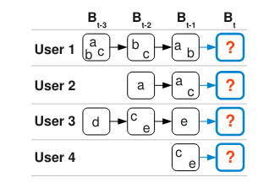
2.1. Factorizing Personalized Markov Chains (FPMC)
Originally applied for the problem of next-basket (set of items) recommendation
Combination of personalization (Matrix Factorization) and sequential information (Markov Chain)

Slide 8


2.1. Factorizing Personalized Markov Chains (FPMC)
Non-personalized Markov Chains
Markov Chains of order m
Too many parameters➔ Need to simplify
Markov chain of order 1

Slide 9
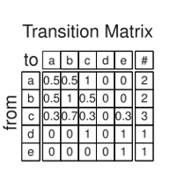


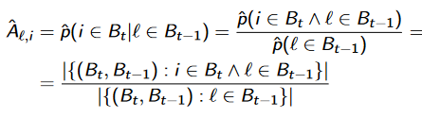

2.1. Factorizing Personalized Markov Chains (FPMC)
Non-personalized Markov Chains
Defined by transition matrix A with size $I^{2}$
To calculate probability of purchasing an item given the last basket
The maximum likelihood estimator of probability ${\hat{A}}_{l,i}$ given the history of baskets B:

Slide 10
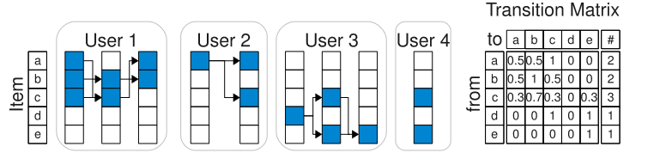
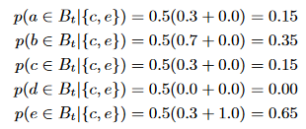
2.1. Factorizing Personalized Markov Chains (FPMC)
Non-personalized Markov Chains: Example
Calculate the items’ probabilities for user 4

Slide 11
2.1. Factorizing Personalized Markov Chains (FPMC)
Non-personalized Markov Chains: Example
Calculate the items’ probabilities for user 4
Item b gets recommended, despite user 3 sharing interests with user 4 and user 3 has purchased Item d
Need to take users’ personalization into account

Slide 12




2.1. Factorizing Personalized Markov Chains (FPMC)
Personalized Markov Chain
User specific Markov chain
Personalized prediction probability for the next basket will be:
Maximum Likelihood Estimation of ${\hat{A}}_{u,l,i}$ for given historical baskets set B is

Slide 13
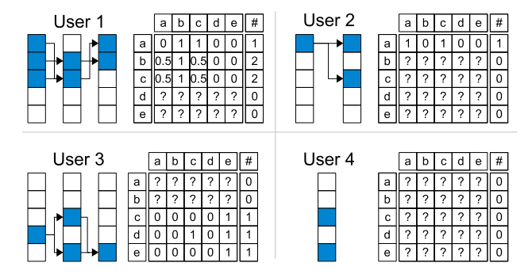
2.1. Factorizing Personalized Markov Chains (FPMC)
Personalized Markov Chain: Example

Slide 14
2.1. Factorizing Personalized Markov Chains (FPMC)
Personalized Markov Chain: Example
Sparse Data ➔ Many parameters can’t be estimated

Slide 15
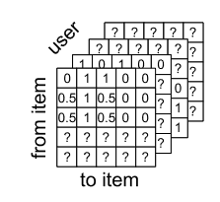

2.1. Factorizing Personalized Markov Chains (FPMC)
Factorizing transition graphs
Stacking all transition matrices of the individual users leads to a transition cube $A$
Derive a factorization model for the transition cube A. That means modeling the unobserved transition tensor A by a low rank approximation $\hat{A}.$

Slide 16


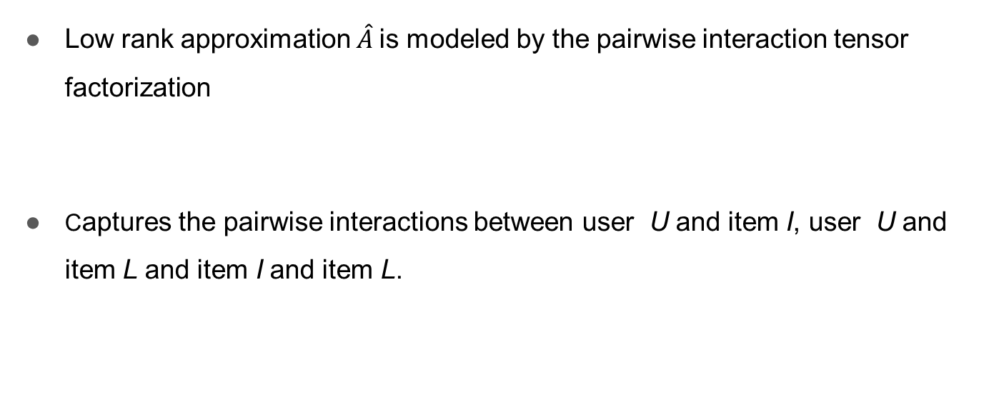
2.1. Factorizing Personalized Markov Chains (FPMC)
Low rank approximation $\hat{A}$is modeled by the pairwise interaction tensor factorization
Captures the pairwise interactions between user U and item I, user U and item L and item I and item L.

Slide 17

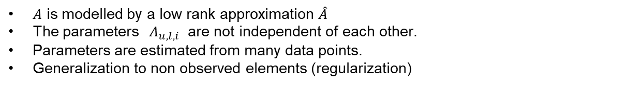
2.1. Factorizing Personalized Markov Chains (FPMC)
Final FPMC MODEL
$A$ is modelled by a low rank approximation $\hat{A}$
The parameters${ A}_{u,l,i}$ are not independent of each other.
Parameters are estimated from many data points.
Generalization to non observed elements (regularization)

Slide 18
2.2 GRU4REC
Takes the current state of the sequence as input
Uses GRU to model sequential behaviors

Slide 19
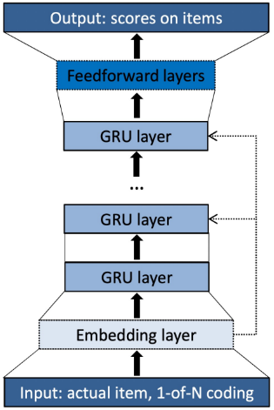
2.2 GRU4REC

Slide 20
2.2 GRU4REC
Can be a single item or a sequence of items
One Item: One-hot encoding
Sequence of items: Sum of encodings of all items

Slide 21
2.2 GRU4REC
GRUs + FC: Captures sequential behavior

Slide 22
2.2 GRU4REC
Softmax: Predict probabilities of next items

Slide 23
2.3 SASREC
Based on self-attention mechanism, similar to Transformer
⇒ Captures the dynamics between different items in the sequence.

Slide 24
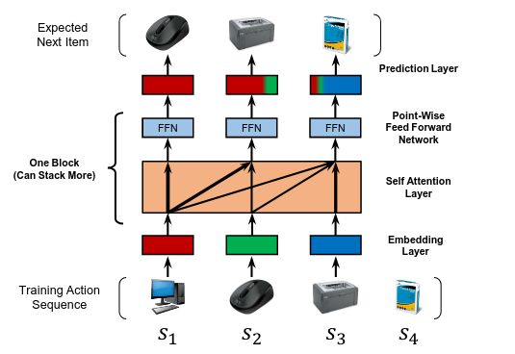
2.3 SASREC

Slide 25
2.3 SASREC
Sequence of items as input

Slide 26
2.3 SASREC
Positional Embedding
Item Embedding

Slide 27

2.3 SASREC
Model interactions between pairs of items

Slide 28
Content
Introduction
Models
Loss Functions
Data
Experimental results
Conclusion

Slide 29
3. Loss Functions
3.1. Cross Entropy Loss
3.2. BPR LOSS
2.3. TOP 1 LOSS

Slide 30
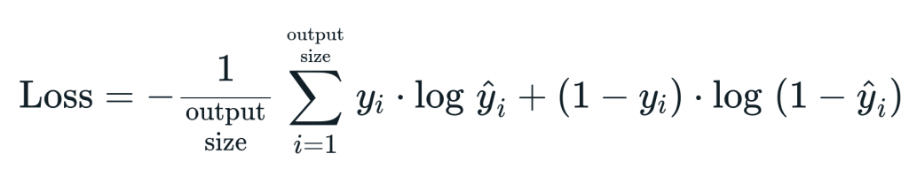
3.1 Loss Functions: Cross Entropy Loss
Standard Cross Entropy loss used for classification tasks
Only learn to correctly label the data, can not rank the relevance of the item.

Slide 31
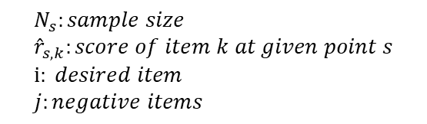

3.2. Loss Functions: BPR Loss
Pairwise ranking loss: compares the score of a positive and a sampled negative item.
Compare the score of the positive item with several sampled items and use their average as the loss
Encourage desired items to have much higher ranks than negative items
$$L_{s}=−\frac{1}{N_{s}}\sum_{j=1}^{N_{s}}{log⁡(σ \left( {\hat{r}}_{s,i} −{\hat{r}}_{s,j}\right))}$$
$$N_{s}:sample size \\ {\hat{r}}_{s,k}:score of item k at given point s \\ i: desired item \\ j:negative items$$

Slide 32

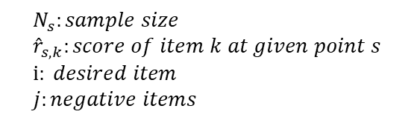
3.3 Loss Functions: TOP 1 Score
Regularized approximation of the relative rank of the target item
$$L_{s}=\frac{1}{N_{s}}\sum_{k=0}^{n}{σ \left( {\hat{r}}_{s,j} −{\hat{r}}_{s,i}\right)+σ ({\hat{r}}_{s,j}^{2})}$$
$$N_{s}:sample size \\ {\hat{r}}_{s,k}:score of item k at given point s \\ i: desired item \\ j:negative items$$

Slide 33

3.3 Loss Functions: TOP 1 Score
Regularized approximation of the relative rank of the target item
$$L_{s}=\frac{1}{N_{s}}\sum_{k=0}^{n}{σ \left( {\hat{r}}_{s,j} −{\hat{r}}_{s,i}\right)+σ ({\hat{r}}_{s,j}^{2})}$$
Approximate the relative rank of the relevant item
$$\frac{1}{N_{s}}\sum_{k=0}^{n}{I \{{\hat{r}}_{s,j}>{\hat{r}}_{s,i}\}}$$
$$N_{s}:sample size \\ {\hat{r}}_{s,k}:score of item k at given point s \\ i: desired item \\ j:negative items$$

Slide 34
Content
1.Introduction
2. Models
3. Loss Functions
4. Data
5. Experimental results
6. Conclusion

Slide 35
4. Data
Amazon Video Games dataset:
Contains the sequential purchases of video games of over 24303 Amazon users
Number of users | 24,303
Number of games | 50,953
Number of interactions | 231,780
Average sequence length | 6,88

Slide 36
4. Data: Data Preprocessing
Represent items with indices
Train – Validation – Test split: Leave-one-out
Leave the last item out as target item for testing
Leave second last item for validation
The rest are used for training

Slide 37
4. Data: Data Preprocessing
Represent items with indices
Train – Validation – Test split: Leave-one-out
Leave the last item out as target item for testing
Leave second last item for validation
The rest are used for training
 | Input Sequence | Target Item
Full sequence | 1,2,3,4,5,6
Train | 1,2,3 | 4
Validation | 1,2,3,4 | 5
Test | 1,2,3,4,5 | 6

Slide 38
4. Data: Data Preprocessing
Represent items with indices
Train – Validation – Test split: Leave-one-out
Turn all sequences into fixed length vectors (fixedLength = 20)
Length > fixedLength: Split into multiple shorter sequences
Length < fixedLength: pad until sufficient length

Slide 39
4. Data: Data Preprocessing
Data Augmentation
Noise Injection
Redundancy Injection
Item Mask

Slide 40
4. Data: Data Preprocessing
Data Augmentation
Noise Injection:
Randomly choose a negative item (not in the sequence), insert into a random position in the sequence
Delete the first item of the original sequence to preserve length
Original sequence | 2,4,6,8,10,12
Augmented sequence | 4,6,3,10,12

Slide 41
4. Data: Data Preprocessing
Data Augmentation
Redundancy Injection
Randomly choose a positive item (in the sequence), insert into a random different position in the sequence
Delete the first item of the original sequence to preserve length
Original sequence | 2,4,6,8,10,12
Augmented sequence | 4,10,8,10,12

Slide 42
4. Data: Data Preprocessing
Data Augmentation
Item Mask
Randomly mask p% of items in the original sequence with 0 (p = 30)
Original sequence | 2,4,6,8,10,12
Augmented sequence | 2,0,8,10,0

Slide 43
Content
1.Introduction
2. Models
3. Loss Functions
4. Data
5. Experimental results
6. Conclusion

Slide 44
5. Experimental results
Experiments
Compare 3 models’ performance
Compare data augmentation methods effectiveness
Compare loss functions’ performance

Slide 45
5. Experimental results
Experiments
Compare 3 models’ performance
Train 3 models with the same training setup: 200 epochs, early stop after 20 epochs, trained on Colab…
Hyper-parameters: According to the original papers
No augmentation
BPR Loss
Compare with a simple baseline POP: a recommender who always outputs the most popular item in the training set.

Slide 46
5. Experimental results
Experiments
Compare data augmentation methods effectiveness
Trained with the best model from the previous experiment
Evaluate effectiveness at different sizes of training data
10%, 25%, 50% and 100% of original training data
Same training setup

Slide 47
5. Experimental results
Experiments
Compare loss functions’ performances
Trained with the best model from the previous experiment
Same training setup

Slide 48
5. Experimental results
Metrics
Hit Rate at top K (HR@K)
Normalized Discount Cumulative Gain (NDCG)

Slide 49
5. Experimental results
Metrics
Hit Rate at top K (HR@K):
Calculates % of ground-truth items among the top K recommended items
K = 10
Normalized Discount Cumulative Gain at top K(NDCG@K):
Between 0 and 1
Takes into account the rank of the score of the actual item among the predicted items
The higher the actual items’ rank, the higher the NDCG
K = 10

Slide 50
5. Experimental results: Models’ performances
Model | HR@10 | NDCG@10
POP | 0.3826 | 0.2186
FPMC | 0.6538 | 0.4217
GRU4REC | 0.6821 | 0.4446
SASREC | 0.6898 | 0.4669

Slide 51
5. Experimental results: Models’ performances
All 3 models achieve great performance compared to the simple baseline
Model | HR@10 | NDCG@10
POP | 0.3826 | 0.2186
FPMC | 0.6538 | 0.4217
GRU4REC | 0.6821 | 0.4446
SASREC | 0.6898 | 0.4669

Slide 52
5. Experimental results: Models’ performances
SASREC best performance
Self-attention is more powerful than Markov Chains or RNNs
Model | HR@10 | NDCG@10
POP | 0.3826 | 0.2186
FPMC | 0.6538 | 0.4217
GRU4REC | 0.6821 | 0.4446
SASREC | 0.6898 | 0.4669

Slide 53
5. Experimental results: Data augmentation
- Trained with SASREC
Data size/ Method | None | Noise Injection | Redundancy Injection | Item Mask
10% | 0.2558 | 0.3118 (+21.9%) | 0.3102 (+21.3%) | 0.2585 (+1.1%)
25% | 0.3587 | 0.3963 (+10.4%) | 0.3961 (+10.4%) | 0.3564 (-0.7%)
50% | 0.4221 | 0.4407 (+4.2%) | 0.4400 (+4.2%) | 0.4365 (+3.4%)
100% | 0.4669 | 0.4702 (+0.7%) | 0.4710 (+0.8%) | 0.4667 (-0%)

Slide 54
5. Experimental results: Data augmentation
- Trained with SASREC
NI and RI is effective in low-data regime
Data size/ Method | None | Noise Injection | Redundancy Injection | Item Mask
10% | 0.2558 | 0.3118 (+21.9%) | 0.3102 (+21.3%) | 0.2585 (+1.1%)
25% | 0.3587 | 0.3963 (+10.4%) | 0.3961 (+10.4%) | 0.3564 (-0.7%)
50% | 0.4221 | 0.4407 (+4.2%) | 0.4400 (+4.2%) | 0.4365 (+3.4%)
100% | 0.4669 | 0.4702 (+0.7%) | 0.4710 (+0.8%) | 0.4667 (-0%)

Slide 55
5. Experimental results: Data augmentation
- Trained with SASREC
Not as effective when data size is large
Data size/ Method | None | Noise Injection | Redundancy Injection | Item Mask
10% | 0.2558 | 0.3118 (+21.9%) | 0.3102 (+21.3%) | 0.2585 (+1.1%)
25% | 0.3587 | 0.3963 (+10.4%) | 0.3961 (+10.4%) | 0.3564 (-0.7%)
50% | 0.4221 | 0.4407 (+4.2%) | 0.4400 (+4.2%) | 0.4365 (+3.4%)
100% | 0.4669 | 0.4702 (+0.7%) | 0.4710 (+0.8%) | 0.4667 (-0%)

Slide 56
5. Experimental results: Data augmentation
- Trained with SASREC
Item Mask is not effective
Maybe masking makes data too noisy ?
Data size/ Method | None | Noise Injection | Redundancy Injection | Item Mask
10% | 0.2558 | 0.3118 (+21.9%) | 0.3102 (+21.3%) | 0.2585 (+1.1%)
25% | 0.3587 | 0.3963 (+10.4%) | 0.3961 (+10.4%) | 0.3564 (-0.7%)
50% | 0.4221 | 0.4407 (+4.2%) | 0.4400 (+4.2%) | 0.4365 (+3.4%)
100% | 0.4669 | 0.4702 (+0.7%) | 0.4710 (+0.8%) | 0.4667 (-0%)

Slide 57
5. Experimental results: Loss functions
- Trained with SASREC
BPR not improving upon Cross Entropy
Loss function | HR@10 | NDCG@10
Cross Entropy | 0.6898 | 0.4645
BPR | 0.6898 (+0%) | 0.4669 (+0.5%)
TOP 1 | 0.7163 (+3.8%) | 0.4847 (+4.3%)

Slide 58
5. Experimental results: Loss functions
- Trained with SASREC
Significant improvement for TOP 1
Learning to rank items’ relevance helps the performance
Loss function | HR@10 | NDCG@10
Cross Entropy | 0.6898 | 0.4645
BPR | 0.6898 (+0%) | 0.4669 (+0.5%)
TOP 1 | 0.7163 (+3.8%) | 0.4847 (+4.3%)

Slide 59
Content
1.Introduction
2. Models
3. Loss Functions
4. Data
5. Experimental results
6. Conclusion

Slide 60
6. Conclusion
Researched, implemented and evaluated three different sequential recommendation models
SASREC achieve higher performance compared to the other 2 thanks to self-attention
Experimented with different data augmentation methods
Data augmentation is more helpful in low data regime
Item Mask not effective
Implemented and experimented different loss functions for sequential recommendation
TOP 1 Loss achieve greater performance

Slide 61
6. Conclusion
Future works:
Explore more advanced models
Incorporate more information: (item meta information, time interval information…)

